Slide 1
WELCOME
Project Name: Basic Calculator Using Stack
Date: 29.05.2025

Slide 2
👉Introduction👈
Purpose: Implement a calculator that evaluates mathematical expressions.
Supported operations: +, -, *, /, %, ^ (power), parentheses.
Challenges: operator precedence, associativity, parentheses handling.

Slide 3
👉Problem Statement👈
Key Problems Solved:
1.Convert infix expressions (human-readable) to postfix (stack-friendly).
2.Evaluate postfix expressions using stacks.
3.Handle errors (mismatched parentheses, division by zero).

Slide 4
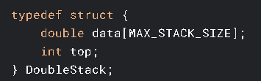
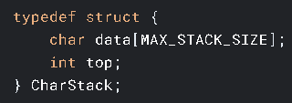
👉Stack Data Structures👈
DoubleStack (for numbers):
CharStack (for operators):
Key Functions:
push(), pop(), peek(), init().

Slide 5
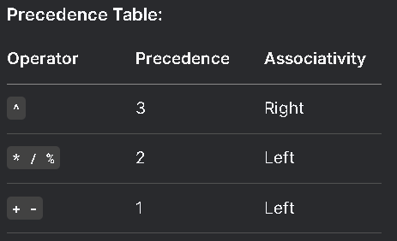
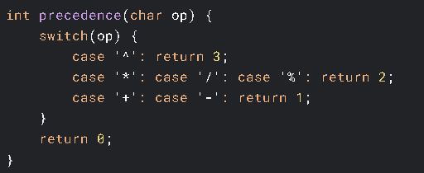
Code:
👉Operator Precedence & Associativity👈

Slide 6
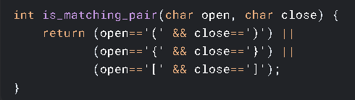
Matching Logic:
(1+2] → Mismatched.
(1+2 → Unmatched.
👉 Parentheses Handling👈
Error Cases:
(1+2] → Mismatched.
(1+2 → Unmatched.

Slide 7
👉 Infix-to-Postfix Conversion👈
Algorithm Steps:
1. Numbers → Output directly.
2. Operators → Push to stack (respect precedence).
3. Parentheses → Push (, pop until ) on match.
Example: Infix: 3 + 4 * 5 → Postfix: 3 4 5 * +

Slide 8

👉 Postfix Evaluation👈
Process:
Numbers → Push to stack.
Operators → Pop operands, compute, push result.
Code Snippet:

Slide 9
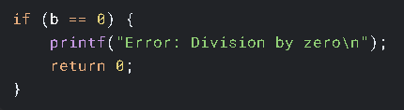
👉 Error Handling👈
Common Errors:
3 / 0 → Division by zero.
3 # 4 → Invalid character.
[1+2) → Mismatched parentheses.
Code:

Slide 10
Demo & Features
Demo Inputs:
Infix: 2 * (3 + 4) → Result: 14.
Postfix: 3 4 5 * + → Result: 23.
Features:
Supports both infix and postfix modes.
Interactive commands (mode, exit)

Slide 11
Let’s see the Result in CODEBLOCKS

Slide 12



Presenters
Ankur ID_159
Tuli ID_160
Manik ID_113

Slide 13

প্রশ্ন করলে গুল্লি করমু

Slide 14


